Slide 1
Introduction of Theano (1)
Hung-yi Lee
Notes:
Only for the dumb

Slide 2
Introduction
Theano is a Python library that lets you to define, optimize, and evaluate mathematical expressions.
Especially useful for machine learning
Prerequisite: python and numpy
http://cs231n.github.io/python-numpy-tutorial/
Target of this class:
Introduce theano from the beginning, so you can build your own DNN by it

Slide 3
Installation

Slide 4
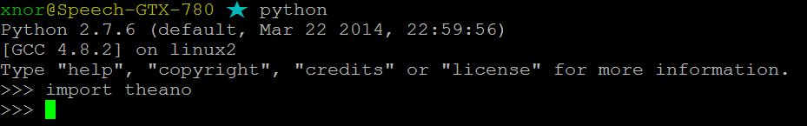
Install Theano
How to install Theano
http://deeplearning.net/software/theano/install.html#install
Make sure there is no error message when you “import theano” in python
E.g.

Slide 5
Basic

Slide 6
Review Machine Learning
Define a function set (Model): f(x; w)
x: input
w: model parameters
Define what is the best function: Define a cost function C(f)
Pick the best function by data: Training
In deep learning, this is usually done by gradient descent.

Slide 7
Power of Theano
After defining a cost function, Theano can automatically compute the gradients.
To use Theano in deep learning you only have to learn
How to define a function
How to compute the gradient
…….. Then that’s it.
Notes:
(the cost function)

Slide 8
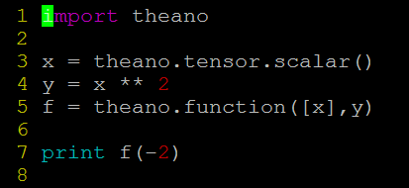
Define function - Overview
E.g. Define a function f(x) = x², then compute f(-2)
Type the left code in a file name “xxx.py”
Execute “python xxx.py”
You should get 4
Step 0. Declare that you want to use Theano (line 1)
Step 1. Define input variable x (line 3)
Step 2. Define output variable y (line 4)
Step 3. Declare the function as f (line 5)
Step 4. Use the function f (line 7)
Notes:
(Details for each step will be provided later)

Slide 9
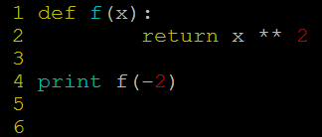
Define function - Overview
E.g. Define a function f(x) = x², then compute f(-2)
Type the left code in a file name “xxx.py”
Execute “python xxx.py”
You should get 4
=
So why we define a function by Theano.
It will be clear when we compute the gradients.

Slide 10
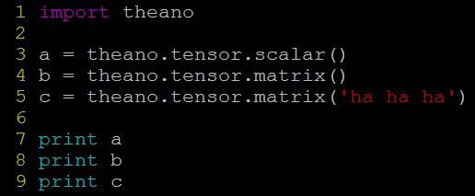
Define function – Step1. Define Input Variables
A variable can be a scalar, a matrix or a tensor
Line 3: declare a scalar a
Line 4: declare a matrix b
Line 5: declare a matrix c with name “ha ha ha”
The name of a variable only make difference when you try to print the variable.

Slide 11

Define function – Step1. Define Input Variables
A variable can be a scalar or a matrix
Line 7,8,9: let’s print the three variables a, b, c to see what we get
a, b, c are symbols without any values
Notes:
We do not know the matrix size either

Slide 12
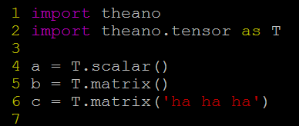
Define function – Step1. Define Input Variables
A variable can be a scalar or a matrix
=
simplification

Slide 13
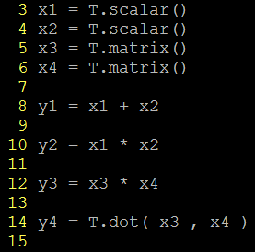
Define function – Step2. Define Output Variables
Output variables are defined based on their relations with the input variables
Below are some examples
y1 equals to x1 plus x2
y2 equals to x1 times x2
y3 is the elementwise multiplication of x3 and x4
y4 is the matrix multiplication of x3 and x4

Slide 14

Define function – Step 3. Declare Function
Declare the function as f
Function input
Function output
Note: the input of a function should be a list.
That is, always put the input in “[ ]”
Define the function input and output explicitly.
(equivalent to the above usage)

Slide 15
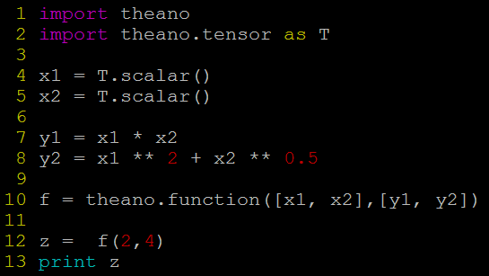
Define function – Step 3. Declare Function
Notes:
Simply put multiple inputs and outputs in the lists

Slide 16
Define function – Step 4. Use Function
Line 12: simply use the function f you declared as a normal python function
Line 13: Print the function output ->
(The theano function output is a numpy.ndarray.)

Slide 17
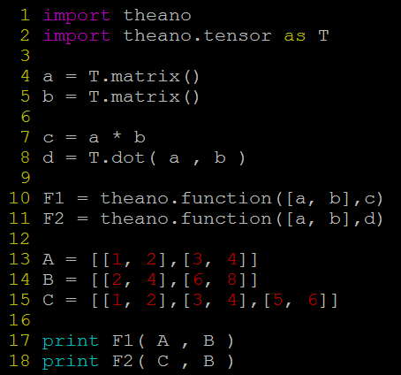
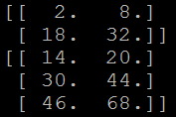
Define function - Examples for Matrix
Output:
Be careful that the dimensions of the input matrices should be correct.
Notes:
When F1 and F2 are defined, the dimensions of the input matrices are not given.
[[ 2. 8.]
[ 18. 32.]]
[[ 14. 20.]
[ 30. 44.]
[ 46. 68.]]

Slide 18
Compute Gradients
Computing the gradients with respect to a variable is so simple.
Given a function with input variable x and output variable y
To compute dy/dx, simply g = T.grad( y , x )
Note: To compute the gradient, y should be a scalar.
That’s it!

Slide 19
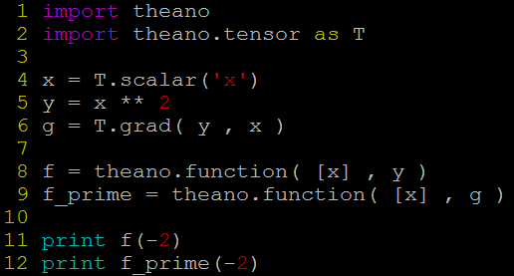
Compute Gradients - Example 1
g = dy/dx = 2x
output “-4”
Notes:
Line 9: define a function f_prime to compute the gradient of y with respect to x ( f_prime(x) = x2 )

Slide 20
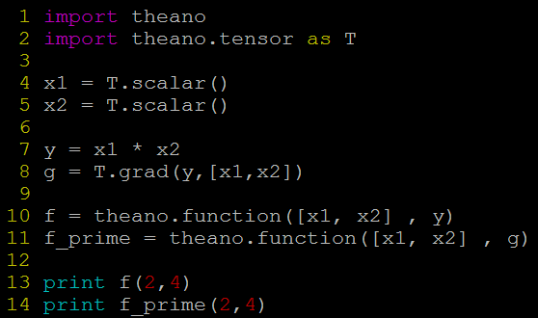
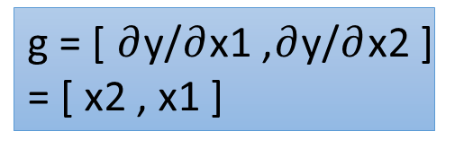
Compute Gradients - Example 2
compute the gradients with respect to multiple variables
g = [ $∂$y/$∂$x1 ,$∂$y/$∂$x2 ] = [ x2 , x1 ]
Notes:
You can replace line 8 with g1,g2 = T.grad(y,[x1,x2]) and line 11 with f_prime = theano.function([x1, x2] , [g1 , g2]), and get the same result.

Slide 21
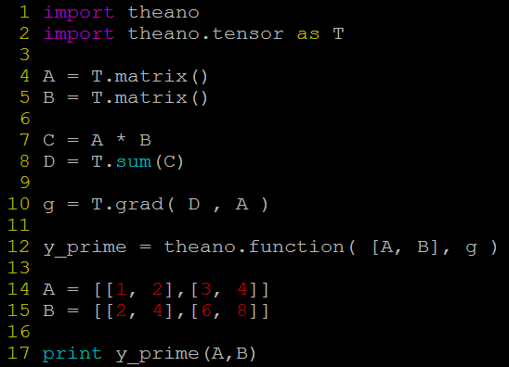
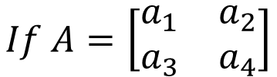

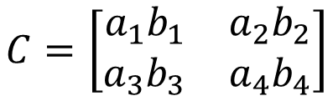
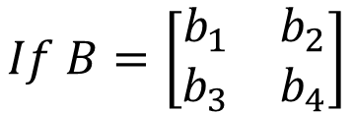
Compute Gradients - Example 3
.
$$If A=\left[\begin{matrix}a_{1} & a_{2} \\ a_{3} & a_{4}\end{matrix}\right]$$
$$If B=\left[\begin{matrix}b_{1} & b_{2} \\ b_{3} & b_{4}\end{matrix}\right]$$
(Note that the dimensions of A and B is not necessary 2 X 2. Here is just an example.)
$$C=\left[\begin{matrix}{a_{1}b}_{1} & {a_{2}b}_{2} \\ {a_{3}b}_{3} & {a_{4}b}_{4}\end{matrix}\right]$$
$$g=\left[\begin{matrix}b_{1} & b_{2} \\ b_{3} & b_{4}\end{matrix}\right]$$
(line 7)
(line 10)
$$D={a_{1}b}_{1}+{a_{2}b}_{2}+{a_{3}b}_{3}+{a_{4}b}_{4}$$
You cannot compute the gradients of C because it is not a scalar
(line 8)

Slide 22
Single Neuron

Slide 23
Single Neuron
First, let’s implement a neuron
Activation function
…
bias
In this stage, let’s assume the model parameters w and b are known

Slide 24
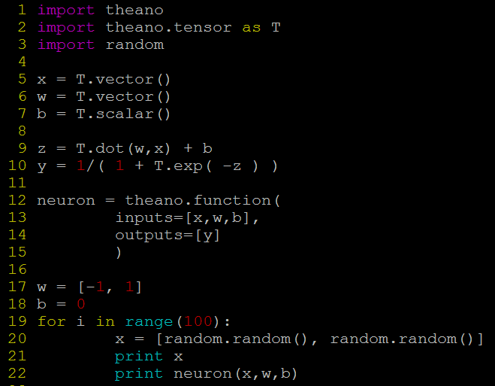
Logistic Regression
y = neuron(x; w, b)

Slide 25
Single Neuron – Shared Variables
In the last example, a neuron is a function with input x, w and b.
However, we usually only consider x as input. w and b are model parameters.
It would be more intuitive if we only have to write “neuron(x)” when using a neuron
The model parameters w and b still influence neuron(.), but in an implicit way.
In Theano, the model parameters are usually stored as shared variables.

Slide 26
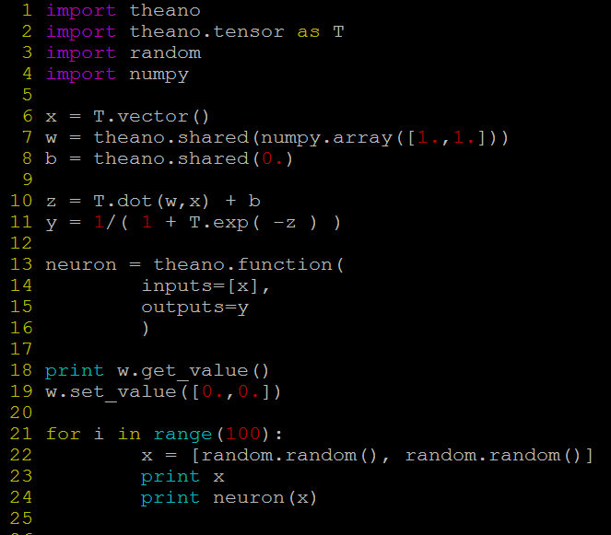
w and b are declared as shared variables.
Initial value
(The shared variables are not symbols.)
x is the only input
The function can access the shared variables.
To get or change the values of the shared variables, you have to use “get_value()” and “set_value()”.

Slide 27
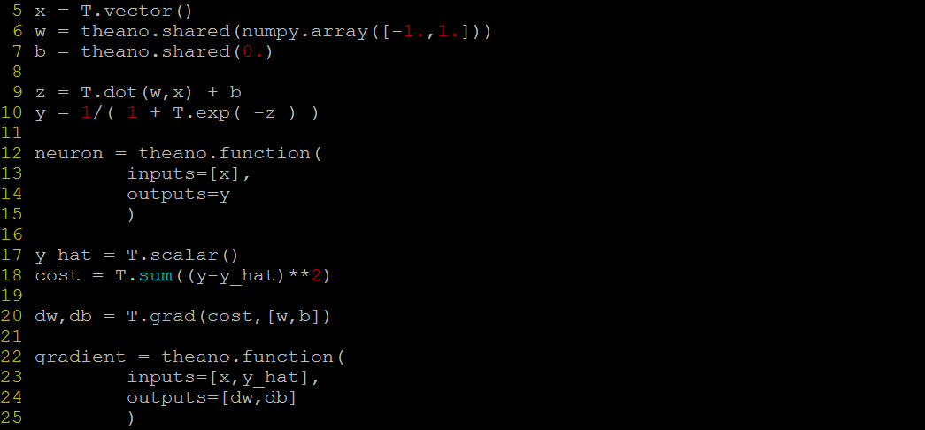

Single Neuron – Training
Define a cost function C
Then compute $\left[\frac{∂C}{∂w_{1}},\frac{∂C}{∂w_{2}},⋯,\frac{∂C}{∂w_{N}}\right]$ and $\frac{∂C}{∂b}$
Reference output value
Define Cost
Computing Gradients
Declare the function for computing gradients

Slide 28
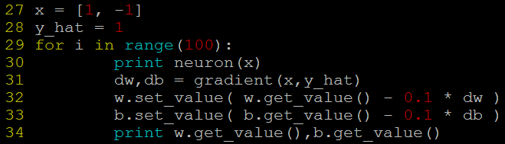
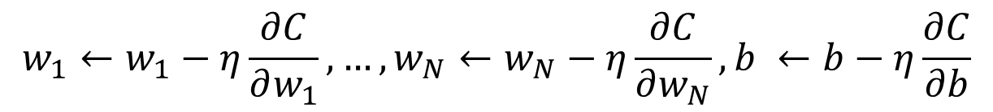
Single Neuron – Gradient Descent
$$w_{1}←w_{1}−η\frac{∂C}{∂w_{1}},…,w_{N}←w_{N}−η\frac{∂C}{∂w_{N}},b ←b−η\frac{∂C}{∂b}$$
Tedious Way:
Compute gradient
Update
Parameters
Line 31: use the function gradient (defined in the last page) to compute the gradients
Line 32, 33: use the gradients to update the model parameters

Slide 29
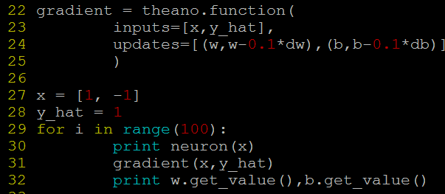
Single Neuron – Gradient Descent
$$w_{1}←w_{1}−η\frac{∂C}{∂w_{1}},…,w_{N}←w_{N}−η\frac{∂C}{∂w_{N}},b ←b−η\frac{∂C}{∂b}$$
Effective Way:
Line 24: updates=“a list of pairs”
Each pair is in the form of (shared-variable, an expression).
Whenever this function runs, it will replace the value of each shared variable with the result of the expression.
Notes:
The other new thing in this code is the updates parameter of function. updates must be supplied with a list of pairs of the form (shared-variable, new expression). It can also be a dictionary whose keys are shared-variables and values are the new expressions. Either way, it means “whenever this function runs, it will replace the .value of each shared variable with the result of the corresponding expression”. Above, our accumulator replaces the state‘s value with the sum of the state and the increment amount.

Slide 30
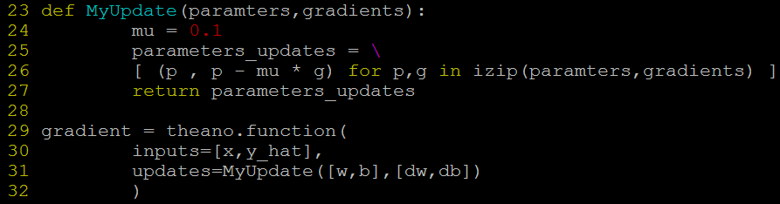
Single Neuron – Gradient Descent
$$w_{1}←w_{1}−η\frac{∂C}{∂w_{1}},…,w_{N}←w_{N}−η\frac{∂C}{∂w_{N}},b ←b−η\frac{∂C}{∂b}$$
Effective Way:
In deep learning, usually sophisticated update strategy is needed.
In this case, you may want to use a function to return the pair list for parameter update.
What is izip?
https://docs.python.org/2/library/itertools.html#itertools.izip
Notes:
The other new thing in this code is the updates parameter of function. updates must be supplied with a list of pairs of the form (shared-variable, new expression). It can also be a dictionary whose keys are shared-variables and values are the new expressions. Either way, it means “whenever this function runs, it will replace the .value of each shared variable with the result of the corresponding expression”. Above, our accumulator replaces the state‘s value with the sum of the state and the increment amount.

Slide 31
Tiny Neural Network

Slide 32
XOR gate
Input |  | Output y
x₁ | x₂
0 | 0 | 0
0 | 1 | 1
1 | 0 | 1
1 | 1 | 0
Can you use three neurons to simulate an XOR gate?
Hidden Neurons
Do it by yourself. You can find a sample code in the following pages.

Slide 33
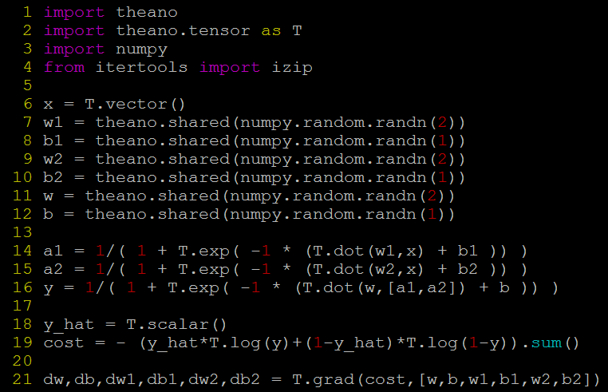
XOR gate

Slide 34
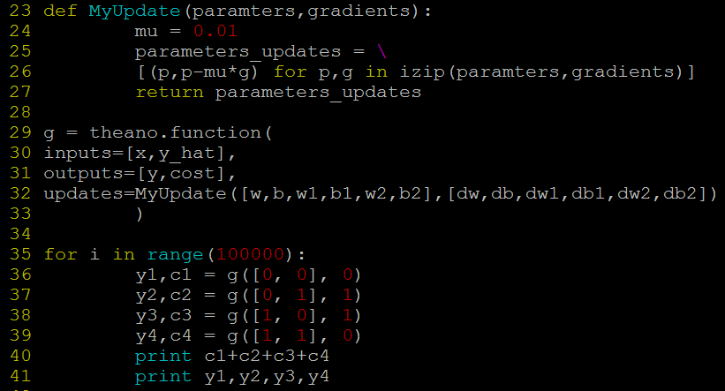
XOR gate
(continued from previous page)
Notes:
Should we have more examples like DNN, SVM, etc.

Slide 35
Neural Network

Slide 36
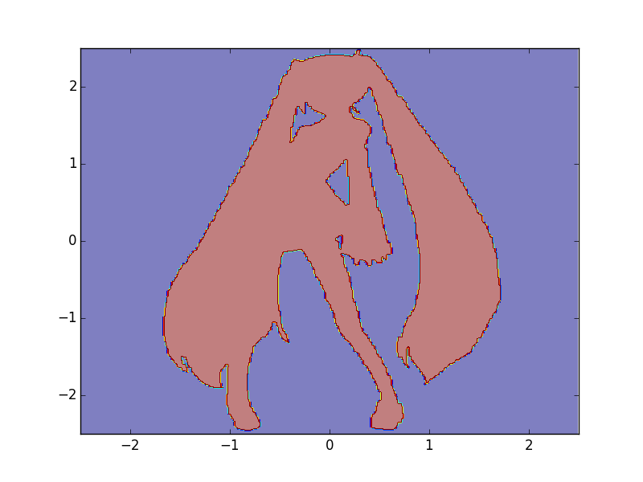

Function of Miku
0
1
http://speech.ee.ntu.edu.tw/~tlkagk/courses/MLDS_2015_2/theano/miku
(1st column: x, 2nd column: y, 3rd column: output (1 or 0) )

Slide 37



Make Minibatch
mk_batch()
Network
Input
Position:
$$\begin{matrix}−2.50 & \text{1.23} & ⋯ \\ −2.50 & −\text{0.54} & ⋯\end{matrix}$$
$$\begin{matrix}−2.50 & −2.50 & ⋯ \\ −2.50 & −2.49 & ⋯\end{matrix}\begin{matrix}\text{1.23} & 1.23 & ⋯ \\ −\text{0.54} & −0.53 & ⋯\end{matrix}$$
$$\begin{matrix}\text{1.23} & −2.50 & ⋯ \\ −\text{0.54} & −2.49 & ⋯\end{matrix}$$
…
Color:
Network
Output
Target
0
1
……
0
0
……
1
1
……
0
1
……
…

Slide 38

Defining Network
W1
W2
W3
input
Hidden Layer 1
Hidden Layer 2
output
b1
b2
b3
Declare network Input
x = T.matrix('input',dtype='float32')
Declare network output
y_hat = T.matrix('reference',dtype='float32')
Declare network parameters
W1 = … (matrix), W2 = …, W3 = …
b1 = … (vector), b2 = … (vector), b3 = … (vector)
parameters = [W1,W2,W3,b1,b2,b3]
Network
Output
Target
Network
Input
$$\begin{matrix}−2.50 & \text{1.23} & ⋯ \\ −2.50 & −\text{0.54} & ⋯\end{matrix}$$
0
1
……

Slide 39
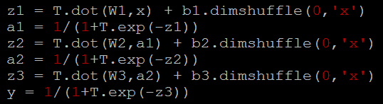
Defining Network
W1
W2
W3
input
Hidden Layer 1
Hidden Layer 2
output
b1
b2
b3
x
z3
y
z1
a1
z2
a2

Slide 40
Minibatch
Ref: https://theano.readthedocs.org/en/rel-0.6rc3/library/tensor/basic.html
W1
x
b1
(Minibatch)
vector
T.dot(W1,x)
b1
b1
b1
b1
+
+ b1.dimshuffle(0,’x’)
More about computing: http://videolectures.net/deeplearning2015_coates_deep_learning/

Slide 41
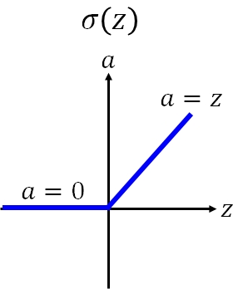
Activation Function - ReLU
If z<0: a = 0
else: a = z
a = T.switch(z<0,0,z)
Other Approaches:
a = T.maximum(z,0)
a = z * (z > 0)

Slide 42
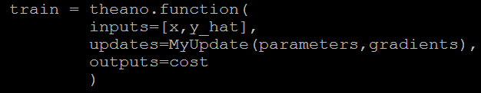

Declaring Functions
Where is backpropagation?
Theano will do backpropagation automatically

Slide 43
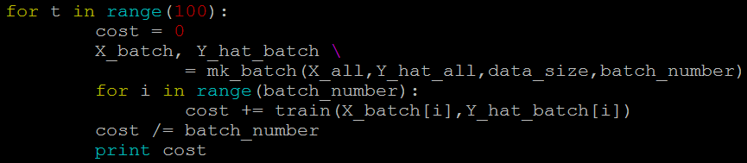

Training & Testing
Training:
Testing:
100 epochs
Generating Batches
Update parameters after seeing each batch
In real learning problem, you should use a validation set to control when to stop.

Slide 44
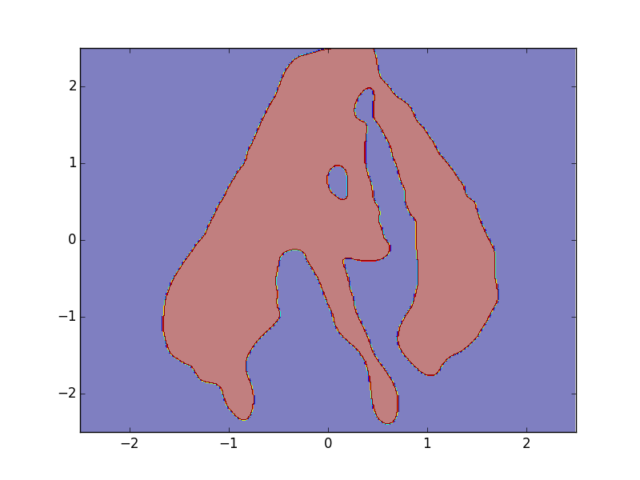
Results
Reference
Network Output
Network Structure: 2-1000-1000-1
Batch size: 1000
Activation function: sigmoid
Learning rate: 0.01 (fixed)

Slide 45
Configuration

Slide 46
Configuration
There are three ways to set the configuration of Theano:
1. modify $HOME/.theanorc
2. set theano.config.<property> in your python code
3. use THEANO_FLAGS when running your python code
E.g. THEANO_FLAGS=mode=FAST_RUN,device=gpu python YourCode.py
Ref: http://deeplearning.net/software/theano/library/config.html
Notes:
Mode: FAST_COMPILE, FAST_RUN, DebugMode
Please refer to 01_basics/02_compiling_and_running/03_bug.py in theano exercise (see the last page)

Slide 47
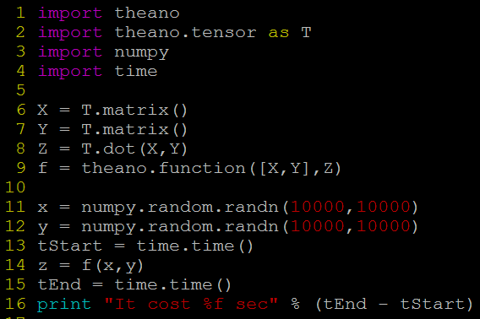

Configuration - GPU
test_gpu.py
Multiplying two 10000 X 10000 matrices
Command:
If the machine has multiple GPUs, using gpu0, gpu1 …. to select a card.
Output:
Command:
Output:
GPU is not helpful? Why?

Slide 48
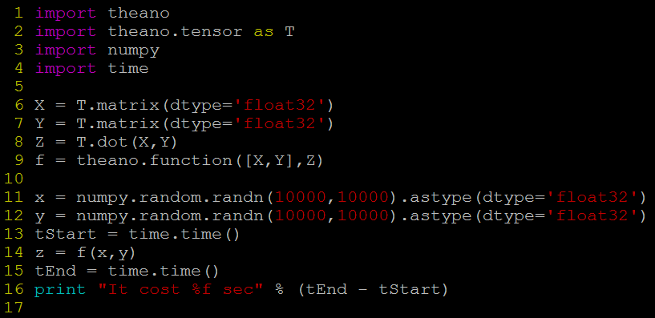
Configuration - GPU
Command:
Output:
More than 20 times faster
Why?
Ref: http://deeplearning.net/software/theano/tutorial/using_gpu.html

Slide 49
More about Configuration
mode=DEBUG_MODE
Theano provides information to help you debug
profile=true
Theano will analyze your program, showing a breakdown of how much is spent on each operation.

Slide 50
To Learn More …
Theano Exercises
https://github.com/goodfeli/theano_exercises
Theano Tutorial
http://deeplearning.net/software/theano/tutorial/index.html#tutorial
Notes:
Introduction to Deep Learning with Python
https://www.youtube.com/watch?v=S75EdAcXHKk
Theano Programming
http://llcao.net/cu-deeplearning15/pdf/Lecture%203.pdf
Deep Learning Summer School 2015 programming tutorials
https://github.com/mila-udem/summerschool2015

Slide 51
Acknowledgement
感謝 陳俊宏 同學發現投影片上的錯誤

